Slide 1
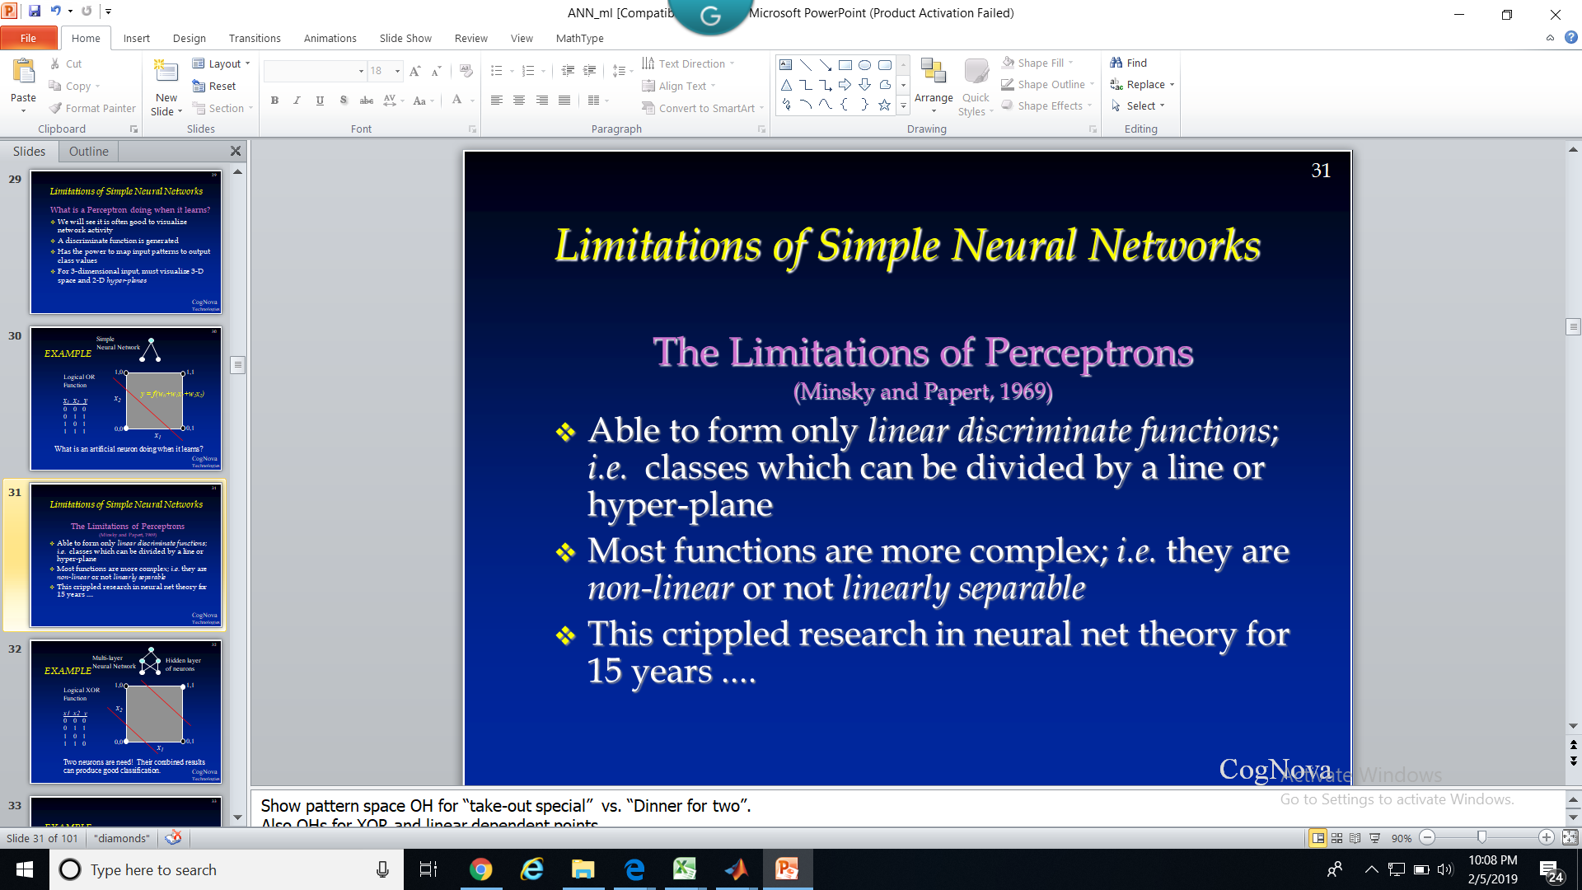
Theory and Application of Artificial Neural Networks
with
Sharad Kumar Tiwari

Slide 2
ANN Background and
Motivation

Slide 3
Background and Motivation
Growth has been explosive since 1987
  education institutions, industry, military
  > 500 books on subject
  > 20 journals dedicated to ANNs
  numerous popular, industry, academic articles
Truly inter-disciplinary area of study
No longer a flash in the pan technology
Notes:
Show OH of multi-disciplinary nature of study of ANNs

Slide 4
Background and Motivation
Computers and the Brain: A Contrast
  Arithmetic: 1 brain = 1/10 pocket calculator
  Vision: 1 brain = 1000 super computers
  Memory of arbitrary details: computer wins
  Memory of real-world facts: brain wins
  A computer must be programmed explicitly
  The brain can learn by experiencing the world

Slide 5

Background and Motivation

Slide 6
Background and Motivation
Inherent Advantages of the Brain:
“distributed processing and representation”
  Parallel processing speeds
  Fault tolerance
  Graceful degradation
  Ability to generalize
I
O
f(x)
x

Slide 7
Background and Motivation
History of Artificial Neural Networks
Creation:
  1890: William James - defined a neuronal process of learning
Promising Technology:
  1943: McCulloch and Pitts - earliest mathematical models
  1954: Donald Hebb and IBM research group - earliest simulations
  1958: Frank Rosenblatt - The Perceptron
Disenchantment:
  1969: Minsky and Papert - perceptrons have severe limitations
Re-emergence:
  1985: Multi-layer nets that use back-propagation
  1986: PDP Research Group - multi-disciplined approach

Slide 8
Background and Motivation
ANN application areas ...
Science and medicine: modeling, prediction,
diagnosis, pattern recognition
Manufacturing: process modeling and analysis
Marketing and Sales: analysis, classification,
customer targeting
Finance: portfolio trading, investment support
Banking & Insurance: credit and policy approval
Security: bomb, iceberg, fraud detection
Engineering: dynamic load schedding, pattern
recognition

Slide 9
Classification Systems and Inductive Learning

Slide 10
Classification Systems and Inductive Learning
Basic Framework for Inductive Learning
Environment
Testing
Examples
Training
Examples
Induced
Model of
Classifier
Inductive
Learning System
~
(x, f(x))
h(x) = f(x)?
A problem of representation and
search for the best hypothesis, h(x).
Output Classification
(x, h(x))

Slide 11
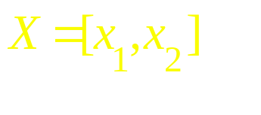
Classification Systems and Inductive Learning
Vector Representation & Discriminate Functions
x
“Input or Attribute
Space”
2
o
o
Height
A
o
o
o
Class Clusters
*
B
*
*
*
*
Age
x
1

Slide 12
Classification Systems and Inductive Learning
Vector Representation & Discriminate Functions
Linear Discriminate
Function
x
2
o
f(X)=(x₁,x₂) =
w₀+w₁x₁+w₂x₂=0
or WX = 0
f(x₁,x₂) > 0 => A
f(x₁,x₂) < 0 => B
o
Height
A
o
o
o
*
B
*
*
*
*
-w₀/w₂
Age
x
1

Slide 13
Classification Systems and Inductive Learning
f(X) = WX =0 will discriminate class A from B,
BUT ... we do not know the appropriate values for :
w₀, w₁, w₂

Slide 14
Classification Systems and Inductive Learning
We will consider one family of neural network classifiers:
continuous valued input
feed-forward
supervised learning
global error
Notes:
Show break-down of ANNs OH (from Lipton)

Slide 15
From Biological to Artificial Neurons

Slide 16
From Biological to Artificial Neurons
The Neuron - A Biological Information Processor
dentrites - the receivers
soma - neuron cell body (sums input signals)
axon - the transmitter
synapse - point of transmission
neuron activates after a certain threshold is met
Learning occurs via electro-chemical changes in effectiveness of synaptic junction.
Notes:
Show the schematic of the biological neuron.

Slide 17
From Biological to Artificial Neurons
An Artificial Neuron - The Perceptron
simulated on hardware or by software
input connections - the receivers
node, unit, or PE simulates neuron body
output connection - the transmitter
activation function employs a threshold or bias
connection weights act as synaptic junctions
Learning occurs via changes in value of the connection weights.
Notes:
Show the schematic of the biological neuron.

Slide 18
From Biological to Artificial Neurons
An Artificial Neuron - The Perceptron
Basic function of neuron is to sum inputs, and produce output given sum is greater than threshold
ANN node produces an output as follows:
1. Multiplies each component of the input pattern by the weight of its connection
2. Sums all weighted inputs and subtracts the threshold value => total weighted input
3. Transforms the total weighted input into the output using the activation function
Notes:
Show schematic of the Perceptron.

Slide 19
From Biological to Artificial Neurons
“Distributed processing
and representation”
O1
O2
Output Nodes
3-Layer Network
has
2 active layers
Hidden Nodes
Input Nodes
I1
I2
I3
I4
Notes:
Ownership of data and knowledge
Security of customer data
Responsibility for accuracy of information
Ethical practices - fair use of data

Slide 20
From Biological to Artificial Neurons
Behaviour of an artificial neural network to any particular input depends upon:
structure of each node (activation function)
structure of the network (architecture)
weights on each of the connections
.... these must be learned !

Slide 21
Learning in a Simple Neuron

Slide 22
Learning in a Simple Neuron
where f(a) is the
step function, such
that: f(a)=1, a > 0
f(a)=0, a <= 0
“Full Meal Deal”
x1
x2
y
w0=
0 0 0
0 1 0
1 0 0
1 1 1
w1
w2
x0=1
x1
x2
Fries
Burger
H = {W|W ∈ R^{(n+1)}}

Slide 23
Learning in a Simple Neuron
Perceptron Learning Algorithm:
1. Initialize weights
2. Present a pattern and target output
3. Compute output :
4. Update weights :
Repeat starting at 2 until acceptable level of error

Slide 24
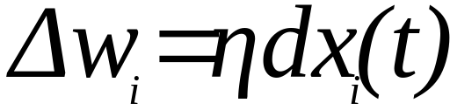
Learning in a Simple Neuron
Widrow-Hoff or Delta Rule for Weight Modification
Where:
η = learning rate (o < η <= 1), typically set = 0.1
d = error signal = desired output - network output
= t - y
;

Slide 25
Learning in a Simple Neuron
Perceptron Learning - A Walk Through
The PERCEPT.XLS table represents 4 iterations through training data for “full meal deal” network
On-line weight updates
Varying learning rate, η , will vary training time
Notes:
Show the table of network parameter values over 4 iterations through the training data for the “full meal deal” network.

Slide 26
TUTORIAL #1
Your ANN software package: A Primer
Develop and train a simple neural network to learn the OR function

Slide 27
Limitations of Simple Neural Networks

Slide 28
Limitations of Simple Neural Networks
What is a Perceptron doing when it learns?
We will see it is often good to visualize network activity
A discriminate function is generated
Has the power to map input patterns to output class values
For 3-dimensional input, must visualize 3-D space and 2-D hyper-planes
Notes:
Show the pattern space slide for “full meal deal”.

Slide 29
EXAMPLE
Simple
Neural Network
1,0
1,1
Logical OR
Function
x₁ x₂ y
0 0 0
0 1 1
0 1
1 1 1
y = f(w₀+w₁x₁+w₂x₂)
x₂
0,0
0,1
x₁
What is an artificial neuron doing when it learns?

Slide 30
Limitations of Simple Neural Networks
The Limitations of Perceptrons
(Minsky and Papert, 1969)
Able to form only linear discriminate functions; i.e. classes which can be divided by a line or hyper-plane
Most functions are more complex; i.e. they are non-linear or not linearly separable
This crippled research in neural net theory for 15 years ....
Notes:
Show pattern space OH for “take-out special” vs. “Dinner for two”.
Also OHs for XOR and linear dependent points.

Slide 31
EXAMPLE
Multi-layer
Neural Network
Hidden layer
of neurons
1,0
1,1
Logical XOR
Function
x1 x2 y
0 0 0
0 1 1
0 1
1 1 0
x₂
0,0
0,1
x₁
Two neurons are need! Their combined results
can produce good classification.

Slide 32
EXAMPLE
B
A
More complex multi-layer networks are needed
to solve more difficult problems.

Slide 33
TUTORIAL #2
Develop and train a simple neural network to learn the XOR function
Also see:
http://www.neuro.sfc.keio.ac.jp/~masato/jv/sl/BP.html

Slide 34
Multi-layer Feed-forward ANNs

Slide 35
Multi-layer Feed-forward ANNs
Over the 15 years (1969-1984) some research continued ...
hidden layer of nodes allowed combinations of linear functions
non-linear activation functions displayed properties closer to real neurons:
  output varies continuously but not linearly
  differentiable .... sigmoid
non-linear ANN classifier was possible
Notes:
Show Multilayer neural network OH
Show XOR network OH.

Slide 36
Multi-layer Feed-forward ANNs
However ... there was no learning algorithm to adjust the weights of a multi-layer network - weights had to be set by hand.
How could the weights below the hidden layer be updated?

Slide 37
Visualizing Network Behaviour

Slide 38
Visualizing Network Behaviour
x1
Pattern Space
Weight Space
Visualizing the process of learning
  function surface in weight space
  error surface in weight space
x2
w0
w2
w1
Notes:
Show pattern space OH.
Show weight space OH with function and error surface.

Slide 39
The Back-propagation Algorithm

Slide 40
The Back-propagation Algorithm
1986: the solution to multi-layer ANN weight update rediscovered
Conceptually simple - the global error is backward propagated to network nodes, weights are modified proportional to their contribution
Most important ANN learning algorithm
Become known as back-propagation because the error is send back through the network to correct all weights

Slide 41
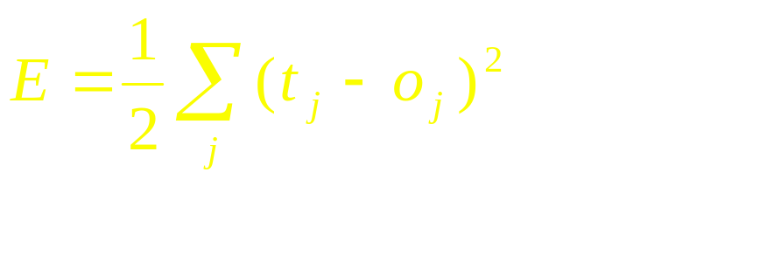
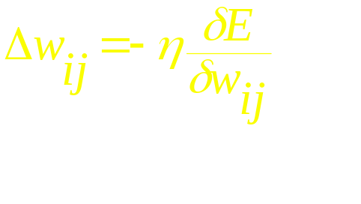
The Back-propagation Algorithm
Like the Perceptron - calculation of error is based on difference between target and actual output:
However in BP it is the rate of change of the error which is the important feedback through the network
generalized delta rule
Relies on the sigmoid activation function for communication
Notes:
Show BP of Network Error OH.
Show sigmoid activation function graph and values.

Slide 42
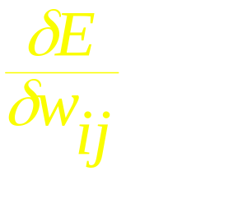


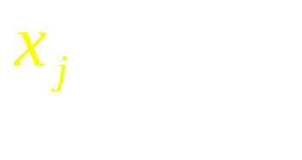
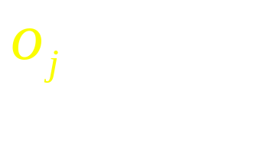
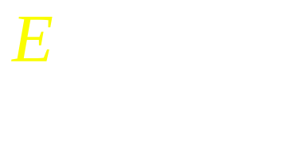
The Back-propagation Algorithm
Objective: compute for all
Definitions:
= weight from node i to node j
= totaled weighted input of node
= output of node
= error for 1 pattern over all output nodes
Notes:
Show BP of Network Error which has the math on it.

Slide 43
The Back-propagation Algorithm
Objective: compute for all
Four step process:
1. Compute how fast error changes as output of node j is changed
2. Compute how fast error changes as total input to node j is changed
3. Compute how fast error changes as weight coming into node j is changed
4. Compute how fast error changes as output of node i in previous layer is changed

Slide 44
The Back-propagation Algorithm
On-Line algorithm:
1. Initialize weights
2. Present a pattern and target output
3. Compute output :
4. Update weights :
where
Repeat starting at 2 until acceptable level of error

Slide 45
The Back-propagation Algorithm
Where:
For output nodes:
For hidden nodes:

Slide 46


The Back-propagation Algorithm
Visualizing the bp learning process:
The bp algorithm performs a gradient descent in weights space toward a minimum level of error using a fixed step size or learning rate
The gradient is given by :
= rate at which error changes as weights change
Notes:
Show Gradient descent and momentum term OH.

Slide 47
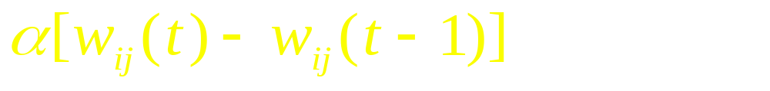
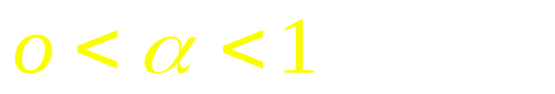
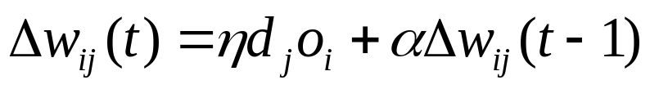
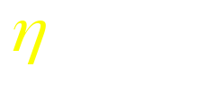
The Back-propagation Algorithm
Momentum Descent:
Minimization can be speed-up if an additional term is added to the update equation:
where:
Thus:
    Augments the effective learning rate to vary the amount a weight is updated
    Analogous to momentum of a ball - maintains direction
    Rolls through small local minima
    Increases weight upadte when on stable gradient

Slide 48
The Back-propagation Algorithm
Line Search Techniques:
Steepest and momentum descent use only gradient of error surface
More advanced techniques explore the weight space using various heuristics
Most common is to search ahead in the direction defined by the gradient

Slide 49
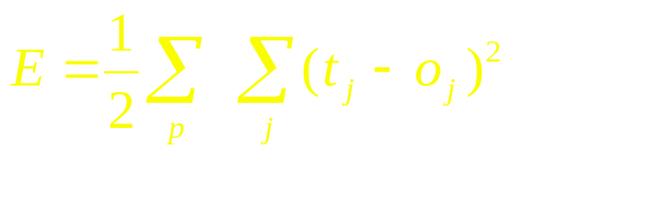
The Back-propagation Algorithm
On-line vs. Batch algorithms:
Batch (or cumulative) method reviews a set of training examples known as an epoch and computes global error:
Weight updates are based on this cumulative error signal
On-line more stochastic and typically a little more accurate, batch more efficient

Slide 50
The Back-propagation Algorithm
Several Interesting Questions:
What is BP’s inductive bias?
Can BP get stuck in local minimum?
How does learning time scale with size of the network & number of training examples?
Is it biologically plausible?
Do we have to use the sigmoid activation function?
How well does a trained network generalize to unseen test cases?

Slide 51
TUTORIAL #3
The XOR function revisited
Software package tutorial :
  Electric Cost Prediction

Slide 52
Generalization

Slide 53
Generalization
The objective of learning is to achieve good generalization to new cases, otherwise just use a look-up table.
Generalization can be defined as a mathematical interpolation or regression over a set of training points:
f(x)
x

Slide 54
Generalization
An Example: Computing Parity
Can it learn from m examples to generalize to all 2^n possibilities?
Parity bit value
+1
-1
+1
>0
>1
>2
(n+1)^2
weights
n bits of input
2^n possible examples

Slide 55
Generalization
Network test of 10-bit parity
(Denker et. al., 1987)
100%
When number of training cases,
m >> number of weights, then
generalization occurs.
Test
Error
0
.25
.50
.75
1.0
Fraction of cases used during training

Slide 56
Generalization
A Probabilistic Guarantee
N = # hidden nodes m = # training cases
W = # weights = error tolerance (< 1/8)
Network will generalize with 95% confidence if:
1. Error on training set <
2.
Based on PAC theory => provides a good rule of practice.

Slide 57
Generalization
Consider 20-bit parity problem:
20-20-1 net has 441 weights
For 95% confidence that net will predict with , we need
training examples
Not bad considering
Notes:
Parity is one of the most difficult problems to learn strictly by example using any method.
It is, in fact, the XOR problem generalized to n bits.
NOTE: most real-world processes/functions which are learnable are not this difficult.
It should also be noted that certain sequences of events or random bit patterns cannot be modeled (example: weather - Kolmogorov showed that compressibility of a sequence is an indicator of its ability to be modeled.
Interesting fact:
(1) consider pie .. probability of compression is 1 -it can be compressed to a very small algorithm, yet its limit is unknown (a transcendental number)
(2) consider a series of 100 random numbers between 1 and 1000 .. probability of compression is less than 1%.
Always consider: It is possible that certain factors effecting a process
may be non-deterministic, in which case the best model will be an approximation

Slide 58
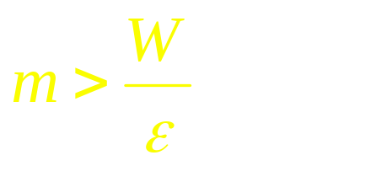
Generalization
Training Sample & Network Complexity
Based on :
W - to reduced size
of training sample
Optimum W=> Optimum #
Hidden Nodes
W - to supply freedom
to construct desired function

Slide 59
Generalization
How can we control number of effective weights?
Manually or automatically select optimum number of hidden nodes and connections
Prevent over-fitting = over-training
Add a weight-cost term to the bp error equation

Slide 60
Generalization
Over-Training
Is the equivalent of over-fitting a set of data points to a curve which is too complex
Occam’s Razor (1300s) : “plurality should not be assumed without necessity”
The simplest model which explains the majority of the data is usually the best
Notes:
Show over-training OH

Slide 61
Generalization
Preventing Over-training:
Use a separate test or tuning set of examples
Monitor error on the test set as network trains
Stop network training just prior to over-fit error occurring - early stopping or tuning
Number of effective weights is reduced
Most new systems have automated early stopping methods

Slide 62
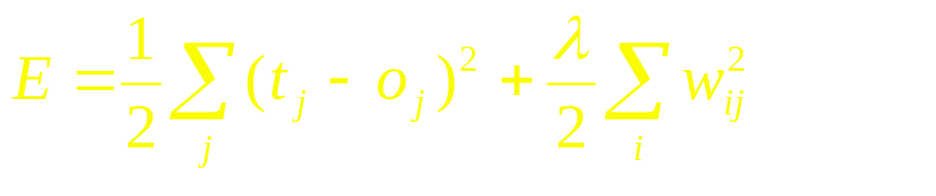
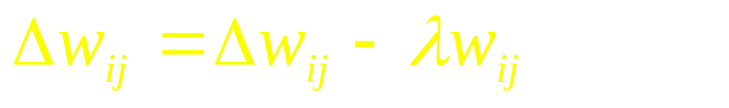
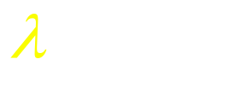

Generalization
Weight Decay: an automated method of effective weight control
Adjust the bp error function to penalize the growth of unnecessary weights:
where: = weight -cost parameter
is decayed by an amount proportional to its magnitude; those not reinforced => 0

Slide 63
TUTORIAL #4
Generalization: Develop and train a BP network to learn the OVT function

Slide 64
Network Design & Training

Slide 65
Network Design & Training Issues
Design:
Architecture of network
Structure of artificial neurons
Learning rules
Training:
Ensuring optimum training
Learning parameters
Data preparation
and more ....

Slide 66
Network Design

Slide 67
Network Design
Architecture of the network: How many nodes?
Determines number of network weights
How many layers?
How many nodes per layer?
  Input Layer Hidden Layer Output Layer
Automated methods:
  augmentation (cascade correlation)
  weight pruning and elimination

Slide 68
Network Design
Architecture of the network: Connectivity?
Concept of model or hypothesis space
Constraining the number of hypotheses:
  selective connectivity
  shared weights
  recursive connections
Notes:
Show 2 OHs of character recognition networks (from Hinton’s notes)

Slide 69
Network Design
Structure of artificial neuron nodes
Choice of input integration:
  summed, squared and summed
  multiplied
Choice of activation (transfer) function:
  sigmoid (logistic)
  hyperbolic tangent
  Guassian
  linear
  soft-max

Slide 70
Network Design
Selecting a Learning Rule
Generalized delta rule (steepest descent)
Momentum descent
Advanced weight space search techniques
Global Error function can also vary
  - normal - quadratic - cubic

Slide 71
Network Training

Slide 72
Network Training
How do you ensure that a network has been well trained?
Objective: To achieve good generalization
accuracy on new examples/cases
Establish a maximum acceptable error rate
Train the network using a validation test set to tune it
Validate the trained network against a separate test set which is usually referred to as a production test set

Slide 73
Network Training
Approach #1: Large Sample
When the amount of available data is large ...
Available Examples
70%
Divide randomly
30%
Training
Set
Production
Set
Generalization error
= test error
Test
Set
Compute
Test error
Used to develop one ANN model

Slide 74
Network Training
Approach #2: Cross-validation
When the amount of available data is small ...
Available Examples
Repeat 10
times
90%
10%
Test
Set
Generalization error
determined by mean
test error and stddev
Training
Set
Pro.
Set
Used to develop 10 different ANN models
Accumulate
test errors

Slide 75
Network Training
How do you select between two ANN designs ?
A statistical test of hypothesis is required to ensure that a significant difference exists between the error rates of two ANN models
If Large Sample method has been used then apply McNemar’s test*
If Cross-validation then use a paired t test for difference of two proportions
*We assume a classification problem, if this is function
approximation then use paired t test for difference of means

Slide 76
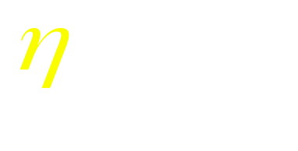
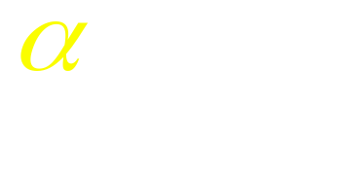
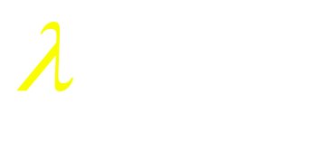
Network Training
Mastering ANN Parameters
Typical Range
learning rate - 0.1 0.01 - 0.99
momentum - 0.8 0.1 - 0.9
weight-cost - 0.1 0.001 - 0.5
Fine tuning : - adjust individual parameters at each node and/or connection weight
  automatic adjustment during training

Slide 77
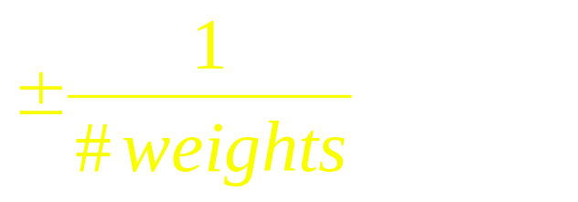
Network Training
Network weight initialization
Random initial values +/- some range
Smaller weight values for nodes with many incoming connections
Rule of thumb: initial weight range should be approximately
coming into a node

Slide 78
Network Training
Typical Problems During Training
E
Steady, rapid decline
in total error
Would like:
# iter
E
Seldom a local minimum - reduce learning or momentum parameter
But
sometimes:
# iter
E
Reduce learning parms.
- may indicate data is not learnable
# iter

Slide 79
Data Preparation

Slide 80
Data Preparation
Garbage in Garbage out
The quality of results relates directly to quality of the data
50%-70% of ANN development time will be spent on data preparation
The three steps of data preparation:
  Consolidation and Cleaning
  Selection and Preprocessing
  Transformation and Encoding

Slide 81
Data Preparation
Data Types and ANNs
Four basic data types:
  nominal discrete symbolic (blue,red,green)
  ordinal discrete ranking (1st, 2nd, 3rd)
  interval measurable numeric (-5, 3, 24)
  continuous numeric (0.23, -45.2, 500.43)
bp ANNs accept only continuous numeric values (typically 0 - 1 range)

Slide 82
Data Preparation
Consolidation and Cleaning
Determine appropriate input attributes
Consolidate data into working database
Eliminate or estimate missing values
Remove outliers (obvious exceptions)
Determine prior probabilities of categories and deal with volume bias

Slide 83
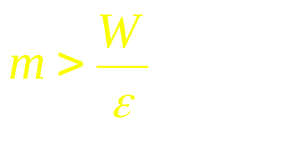
Data Preparation
Selection and Preprocessing
Select examples random sampling
Consider number of training examples?
Reduce attribute dimensionality
  remove redundant and/or correlating attributes
  combine attributes (sum, multiply, difference)
Reduce attribute value ranges
  group symbolic discrete values
  quantize continuous numeric values

Slide 84
Data Preparation
Transformation and Encoding
Nominal or Ordinal values
Transform to discrete numeric values
Encode the value 4 as follows:
  one-of-N code (0 1 0 0 0) - five inputs
  thermometer code ( 1 1 1 1 0) - five inputs
  real value (0.4)* - one input if ordinal
Consider relationship between values
  (single, married, divorce) vs. (youth, adult, senior)
  * Target values should be 0.1 - 0.9 , not 0.0 - 1.0 range

Slide 85
Data Preparation
Transformation and Encoding
Interval or continuous numeric values
De-correlate example attributes via normalization of values:
  Euclidean: n = x/sqrt(sum of all x^2)
  Percentage: n = x/(sum of all x)
  Variance based: n = (x - (mean of all x))/variance
Scale values using a linear transform if data is uniformly distributed or use non-linear (log, power) if skewed distribution

Slide 86
Data Preparation
Transformation and Encoding
Interval or continuous numeric values
Encode the value 1.6 as:
  Single real-valued number (0.16)* - OK!
  Bits of a binary number (010000) - BAD!
  one-of-N quantized intervals (0 1 0 0 0)
  - NOT GREAT! - discontinuities
  distributed (fuzzy) overlapping intervals
  ( 0.3 0.8 0.1 0.0 0.0) - BEST!
  * Target values should be 0.1 - 0.9 , not 0.0 - 1.0 range

Slide 87
TUTORIAL #5
Develop and train a BP network on real-world data
Also see slides covering Mitchell’s Face Recognition example

Slide 88
Post-Training Analysis

Slide 89
Post-Training Analysis
Examining the neural net model:
Visualizing the constructed model
Detailed network analysis
Sensitivity analysis of input attributes:
Analytical techniques
Attribute elimination

Slide 90
Post-Training Analysis
Visualizing the Constructed Model
Graphical tools can be used to display output response as selected input variables are changed
Response
Temp
Size

Slide 91
Post-Training Analysis
Detailed network analysis
Hidden nodes form internal representation
Manual analysis of weight values often difficult - graphics very helpful
Conversion to equation, executable code
Automated ANN to symbolic logic conversion is a hot area of research

Slide 92
Post-Training Analysis
Sensitivity analysis of input attributes
Analytical techniques
  factor analysis
  network weight analysis
Feature (attribute) elimination
  forward feature elimination
  backward feature elimination

Slide 93
The ANN Application Development Process
Guidelines for using neural networks
1. Try the best existing method first
2. Get a big training set
3. Try a net without hidden units
4. Use a sensible coding for input variables
5. Consider methods of constraining network
6. Use a test set to prevent over-training
7. Determine confidence in generalization through cross-validation

Slide 94
Example Applications
Pattern Recognition (reading zip codes)
Signal Filtering (reduction of radio noise)
Data Segmentation (detection of seismic onsets)
Data Compression (TV image transmission)
Database Mining (marketing, finance analysis)
Adaptive Control (vehicle guidance)

Slide 95
Pros and Cons of Back-Prop

Slide 96
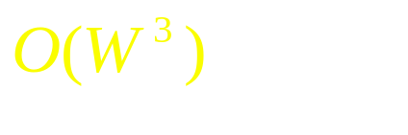
Pros and Cons of Back-Prop
Cons:
Local minimum - but not generally a concern
Seems biologically implausible
Space and time complexity: lengthy training times
It’s a black box! I can’t see how it’s making decisions?
Best suited for supervised learning
Works poorly on dense data with few input variables

Slide 97
Pros and Cons of Back-Prop
Pros:
Proven training method for multi-layer nets
Able to learn any arbitrary function (XOR)
Most useful for non-linear mappings
Works well with noisy data
Generalizes well given sufficient examples
Rapid recognition speed
Has inspired many new learning algorithms

Slide 98
Other Networks and
Advanced Issues

Slide 99
Other Networks and Advanced Issues
Variations in feed-forward architecture
  jump connections to output nodes
  hidden nodes that vary in structure
Recurrent networks with feedback connections
Probabilistic networks
General Regression networks
Unsupervised self-organizing networks

Slide 100
THE END
Thanks for your participation!

